Slide 1
Souper Bowl of Caring
Brand Guidelines

Slide 2
WELCOME
Welcome to Souper Bowl of Caring’s brand and resources guide. We are grateful for the continued support we have received from passionate individuals, youth groups, churches, schools, food banks, grocery stores, NFL teams and companies for over 30 years generating over $160 million in donations of food, funds and service.
Our hope is that recognition of the Souper Bowl of Caring logo will continue to serve as a beacon for hope, unity and awareness for those who are food insecure and to those who can make a difference.

Slide 3
ABOUT US
In 1990, a simple prayer, “ Lord, even as we enjoy the Super Bowl football game, help us to be mindful of those without a bowl of soup to eat” launched a grassroots, youth-led movement working to raise awareness, food and monetary donations for food pantries, soup kitchens, food banks and other hunger-relief charities within their community.

Slide 4
ABOUT US
Mission: Empowering youth and uniting communities to #TackleHunger using the energy of the Big Game.
Vision: Transforming the Big Game into a nation-wide movement inspiring people to give locally and make a collective impact on hunger.
All donations go directly to each participant’s ”Charity of Choice”.

Slide 5
SOUPER BOWL OF CARING LOGO
Since 1990, Souper Bowl of Caring has continued to grow across the country with thousands of groups uniting together to help their neighbors-in-need. The strength of groups, companies, NFL teams and passionate individuals working to serve the greater good is captured in the logo.
The traditional Souper Bowl of Caring logo showcases a soup ladle filled with hot soup as the “o” in bowl, the year on the outside of the logo establishes when Souper Bowl of Caring began, the website URL below Souper Bowl of Caring shares our mission to tackle hunger and direct others to find out more and learn how they can participate.
Our logo serves to strengthen the Souper Bowl of Caring identity and further our mission. Consistency is the key as we work to create a strong identity, community message and build awareness.

Slide 6
LOGO USAGE GUIDELINES
To maintain consistency and brand awareness, only Souper Bowl of Caring creates logos.
The Souper Bowl of Caring logo should not be altered and should include the entire logo, service mark and website URL in an upright position at all times.
The Souper Bowl of Caring name and logo should never be shortened when spoken or written, unless using the term or abbreviation, SBoC.

Slide 7
LOGO USAGE GUIDELINES
In addition, the Souper Bowl of Caring logo should never be used in conjunction with SUPER BOWL, SUPER SUNDAY or GAMEDAY which are trademarked terms by the NFL.
In addition, team logos, players names should also be avoided. To ensure full transparency, you can add a disclosure to your promotional materials that your event is not NFL sponsored, not an official NFL event or endorsed by the NFL.
To promote your SBoC event you may use the term “Tackle Hunger”, “The Big Game” and “Big Game” and use generic football terms and graphics.

Slide 8
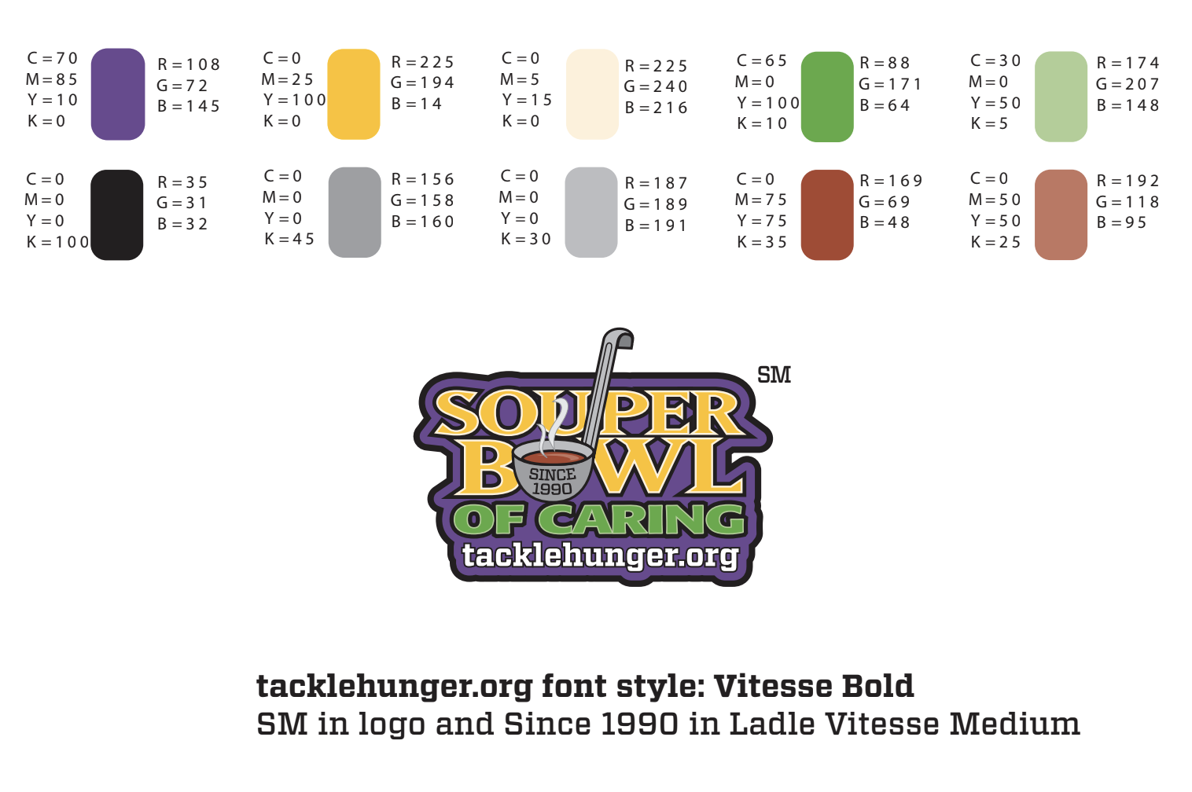
SOUPER BOWL OF CARING
UPDATED TRADITIONAL LOGO

Slide 9
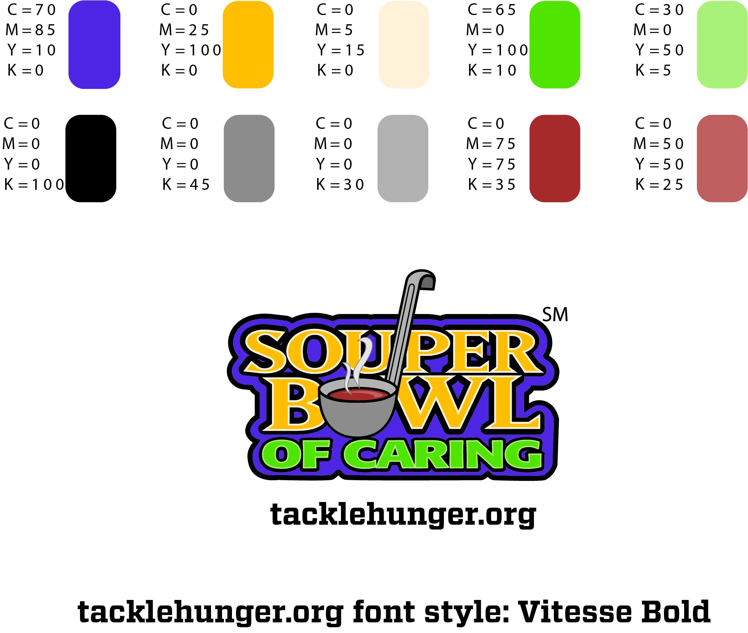
ADDITIONAL TRADITIONAL LOGOS
Color + Black & White
*The Full Color Logo is Souper Bowl of Caring’s primary logo. Please allow for clear space on all sides of logo including website URL. Do not overlay on busy backgrounds and when necessary the Black & White Logo may be used.
Tacklehunger.org font style: Vitesse Bold

Slide 10
TRADITIONAL LOGO
For Use on Dark Colored Background
Tacklehunger.org font style: Vitesse Bold

Slide 11

2021 THEME LOGO
Bigger than the Bowl

Slide 12
2020 THEME LOGO
Highlighting 30TH Anniversary

Slide 13
LINKS TO SOUPER BOWL OF CARING LOGOS
Souper Bowl of Caring UPDATED Traditional Logo Color
Souper Bowl of Caring UPDATED Traditional Logo Black & White
Souper Bowl of Caring Traditional Logo Color
Souper Bowl of Caring Traditional Logo Black & White
2021 Bigger than the Bowl Theme Logo
2020 30th Anniversary Theme Logo
*ADD CLICK THRU LINKS TO TEXT ABOVE

Slide 14
TALKING POINTS
It’s simple to participate:
Register your team at TackleHunger.org
Set your dates and a goal
Collect food or monetary donations
Donate your collection to your Charity of Choice

Slide 15
TALKING POINTS
Serve at a hunger-relief charity near you
Report your collection and volunteer hours at TackleHunger.org to be counted towards the National Total
To learn more visit TackleHunger.org.
Be sure to check out Souper Bowl of Caring’s Tackle Hunger Map and learn more about hunger in your community.

Slide 16
IMAGES, VIDEO & SOCIAL MEDIA
As a champion for hunger, we hope you will post images of your Souper Bowl of Caring campaign, highlight your organization and collection, share volunteerism and the spirit of giving.
Souper Bowl of Caring hosts a number of videos on YouTube throughout the year to share our vision, recruit participants, hunger education, highlight hunger-relief charities and share our success. We encourage you to share our videos or create your own.

Slide 17
IMAGES, VIDEO + SOCIAL MEDIA
Help us spread awareness, hope and inspiration to others working to #TackleHunger in local communities by including and sharing Souper Bowl of Caring on social media. Connect with us on:
Facebook
Twitter
YouTube
CONTACT:
For questions or information about logo usage or social media, contact Marketing & Communications Director, Rhett@SouperBowl.org.

